Slide 1
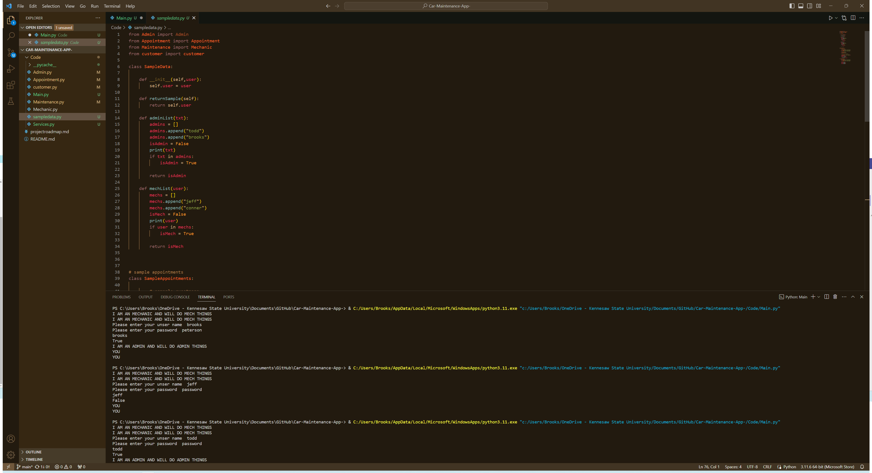
The Mechanic
Project Members: Brooks Peterson
This app serves as a comprehensive vehicle maintenance tracker, allowing users to store and manage information about their vehicle's maintenance activities. Additionally, the app provides a reporting feature and alerts users about upcoming maintenance needs.

